Slide 1
Analysis of Community Structures and User Interactions in the Facebook Social Graph
Presentation was created by:
Daria Zabelina
Artyom Gotovtsev

Slide 2
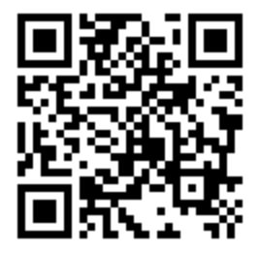
Preliminary part
The purpose of the project is gain detailed insights into how users form communities and interact within these groups on Facebook
Check-list
❌ 1. Project repository inside https://github.com/SNA-23
✅ 6. Roles in team
Each member is responsible for various aspects of data preprocessing, analysis and visualization to ensure comprehensive research outcomes
✅ 2. Project communication channel
Link: https://t.me/+hdVSeLnWr-IyZTYy
✅ 3. Project members
Daria Zabelina, Artyom Gotovtsev
Notes:
http://qrcoder.ru/code/?https%3A%2F%2Ft.me%2F%2BhdVSeLnWr-IyZTYy&4&0

Slide 3
Preliminary part
The purpose of the project is gain detailed insights into how users form communities and interact within these groups on Facebook
Check-list
✅ 4. Key idea and description of the project
The project titled "Analysis of Community Structures and User Interactions in the Facebook Social Graph" aims to explore how users form groups and interact within these communities on Facebook. The primary objective is to analyze and understand the complex networks of user connections on Facebook to enhance scientific knowledge and offer practical applications for improving user engagement and community management on social media platforms
✅ 5. The goal of the project and steps to reach the goal
The goal of the project is to gain detailed insights into how users form communities and interact within these groups on Facebook
To achieve this goal, the following objectives were set:
– to construct a social graph with nodes representing users and edges showing their interactions
– to use advanced community detection algorithms to identify different user groups
– to conduct centrality analysis to find key influencers in the network
– to analyze interactions to understand the roles and influence of different users
– to visualize the network using tools like Gephi or NetworkX
Notes:
http://qrcoder.ru/code/?https%3A%2F%2Ft.me%2F%2BhdVSeLnWr-IyZTYy&4&0

Slide 4
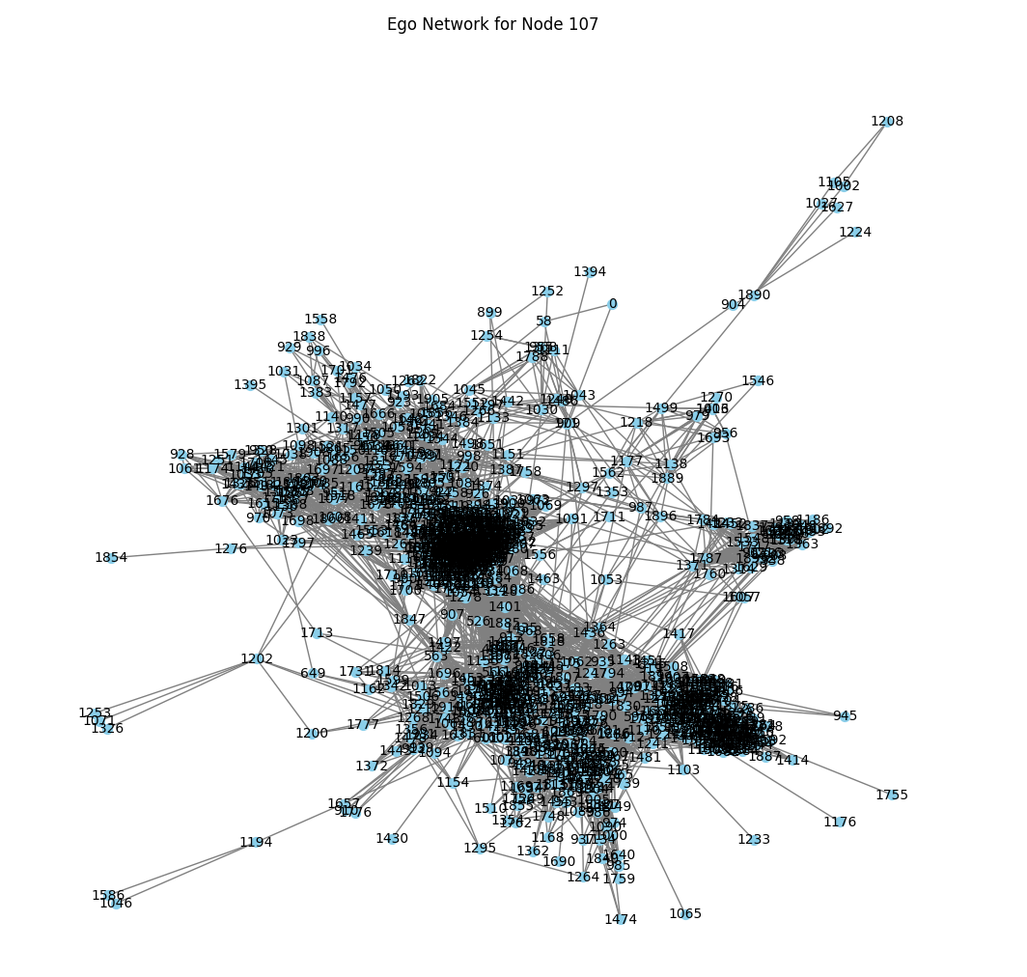
Current state of the work
The purpose of the project is gain detailed insights into how users form communities and interact within these groups on Facebook
Check-list
✅ 7a. Description of the research dataset
The research utilizes a dataset downloaded from the Stanford Network Analysis Project (SNAP)¹, specifically from the "Social circles: Facebook" dataset. The dataset, extracted from a file named "facebook.tar.gz," includes:
“edges” files containing edges for each node's ego network
“circles”, files containing circle information for each node's ego network
“feat” and .”egofeat”, files containing feature information for nodes in the edge files and ego nodes, respectively
“featnames”, files listing the names of each feature dimension
✅ 7b. Network design and framing
The network design involves constructing graphs where nodes represent individual users and edges denote interactions between them. Using NetworkX, nodes are automatically managed based on the edges defined in the .edges files for each ego network
✅ 7c. Network description (were computed)
Centrality measures have been computed to understand the importance and influence of nodes within the network
The network diameter, representing the longest shortest path between any two nodes, varies across ego networks
Network density, indicating the proportion of possible connections that are actual connections
1 – Social circles: Facebook. [Electronic resource] URL: https://snap.stanford.edu/data/ego-Facebook.html (access date 14/05/2024)
Notes:
http://qrcoder.ru/code/?https%3A%2F%2Ft.me%2F%2BhdVSeLnWr-IyZTYy&4&0

